Slide 2
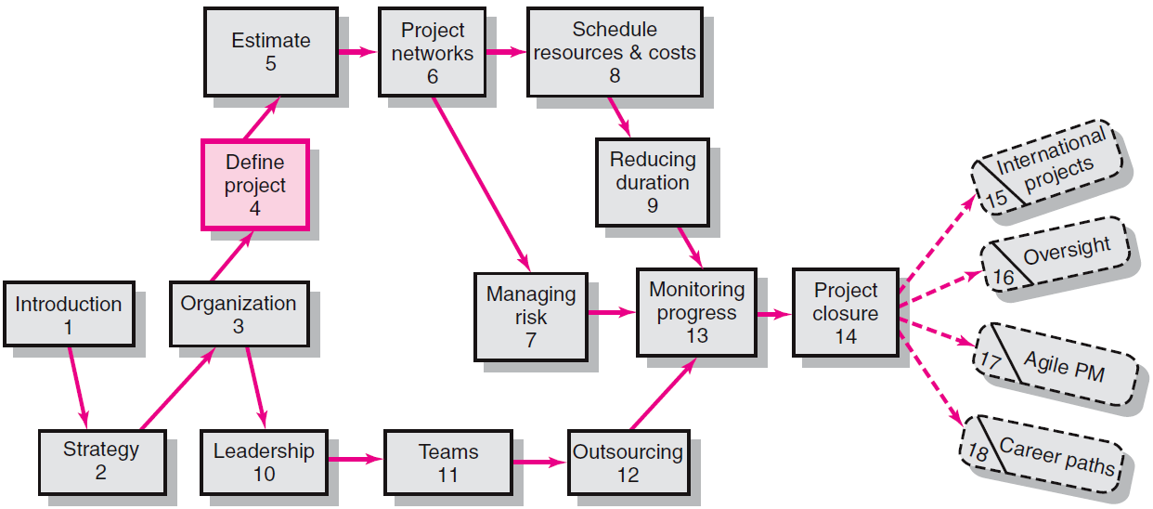
Where We Are Now
4–<number>

Slide 3
Defining the Project
Step 1: Defining the Project Scope
Step 2: Establishing Project Priorities
Step 3: Creating the Work Breakdown Structure
Step 4: Integrating the WBS with the Organization
Step 5: Coding the WBS for the Information System
4–<number>

Slide 4
Step 1: Defining the Project Scope
Project Scope
  A definition of the end result or mission of the project—a product or service for the client/customer—in specific, tangible, and measurable terms.
Purpose of the Scope Statement
  To clearly define the deliverable(s) for the end user.
  To focus the project on successful completion
  of its goals.
  To be used by the project owner and participants
  as a planning tool and for measuring project success.
4–<number>

Slide 5

Project Scope Checklist
Project objective
Deliverables
Milestones
Technical requirements
Limits and exclusions
Reviews with customer
4–<number>

Slide 6
Project Scope: Terms and Definitions
Scope Statements
  Also called statements of work (SOW)
Project Charter
  Can contain an expanded version of scope statement
  A document authorizing the project manager to initiate and lead the project.
Scope Creep
  The tendency for the project scope to expand over time due to changing requirements, specifications, and priorities which ultimately results in added costs and possible project delays.
4–<number>

Slide 7
Step 2: Establishing Project Priorities
Causes of Project Trade-offs
  Shifts in the relative importance of criterions related
  to cost, time, and performance parameters
    Budget–Cost
    Schedule–Time
    Performance–Scope
Managing the Priorities of Project Trade-offs
  Constrain: a parameter is a fixed requirement.
  Enhance: optimizing a criterion over others.
  Accept: reducing (or not meeting) a criterion requirement.
4–<number>

Slide 8
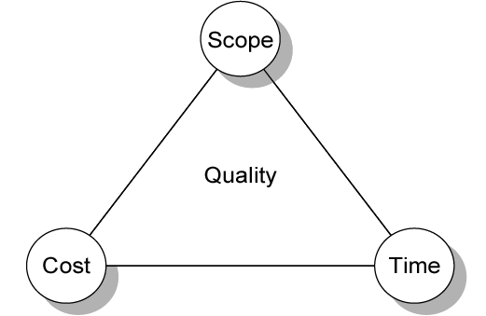
Project Management Trade-offs
FIGURE 4.1

Slide 9
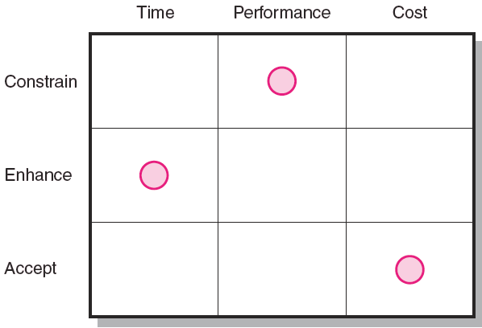
Project Priority Matrix
FIGURE 4.2

Slide 10
Step 3: Creating the Work
Breakdown Structure
Work Breakdown Structure (WBS)
  An hierarchical outline (map) that identifies the products and work elements involved in a project.
  Defines the relationship of the final deliverable
  (the project) to its subdeliverables, and in turn,
  their relationships to work packages.
4–<number>

Slide 11
How WBS Helps the Project Manager
WBS
  Facilitates evaluation of cost, time, and technical performance of the organization on a project.
  Best suited for design and build projects that have tangible outcomes rather than process-oriented projects
  Provides management with information appropriate
  to each organizational level.
4–<number>

Slide 12
How WBS Helps the Project Manager
WBS
  Helps in the development of the organization breakdown structure (OBS). which assigns project responsibilities to organizational units and individuals
  Helps manage plan, schedule, and budget.
  Defines communication channels and assists
  in coordinating the various project elements.
4–<number>

Slide 13
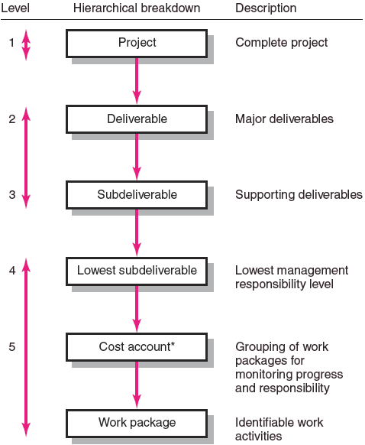
Hierarchical Breakdown of the WBS
FIGURE 4.3

Slide 14
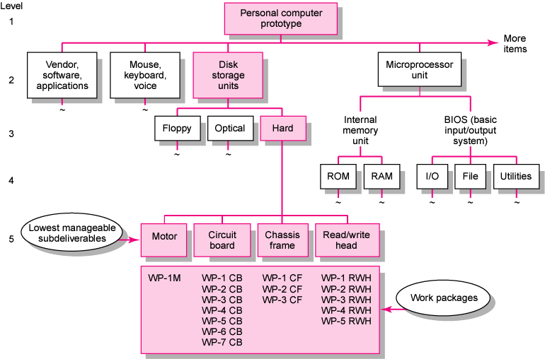
Work Breakdown Structure
FIGURE 4.4

Slide 15
Work Packages
A work package is the lowest level of the WBS.
  It is output-oriented in that it:
    Defines work (what).
    Identifies time to complete a work package (how long).
    Identifies a time-phased budget to complete
    a work package (cost).
    Identifies resources needed to complete
    a work package (how much).
    Identifies a person responsible for units of work (who).
    Identifies monitoring points (milestones)
    for measuring success.
4–<number>

Slide 16
Step 4: Integrating the WBS
with the Organization
Organizational Breakdown Structure (OBS)
  Depicts how the firm is organized to discharge its work responsibility for a project.
    Provides a framework to summarize
    organization work unit performance.
    Identifies organization units responsible
    for work packages.
    Ties the organizational units
    to cost control accounts.
4–<number>

Slide 17

Step 5: Coding the WBS for
the Information System
WBS Coding System
  Defines:
    Levels and elements of the WBS
    Organization elements
    Work packages
    Budget and cost information
  Allows reports to be consolidated at any level in the organization structure
4–<number>

Slide 18
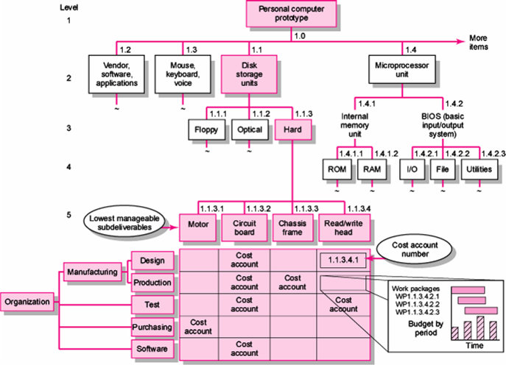
Integration of WBS and OBS
FIGURE 4.5

Slide 19
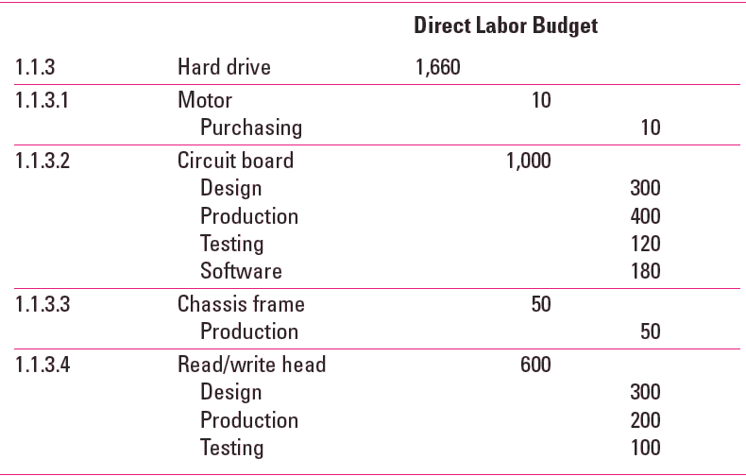
Direct Labor Budget Sorted By WBS
TABLE 4.1A

Slide 20
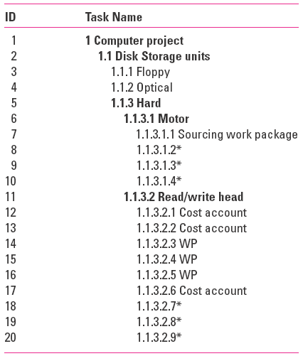
WBS Coding

Slide 21
Project Roll-up
Cost Account
  The intersection of the WBS and the OBS that is a budgetary control point for work packages.
  Used to provide a roll-up (summation) of costs incurred over time by a work package across organization units and levels, and by deliverables.

Slide 22
Process Breakdown Structure
Process-Oriented Projects
  Are driven by performance requirements in which the final outcome is the product of a series of steps of phases in which one phase affects the next phase.
Process Breakdown Structure (PBS)
  Defines deliverables as outputs required to move to the next phase .
  Checklists for managing PBS:
    Deliverables needed to exit one phase and begin the next.
    Quality checkpoints for complete and accurate deliverables.
    Sign-offs by responsible stakeholders to monitor progress.

Slide 23
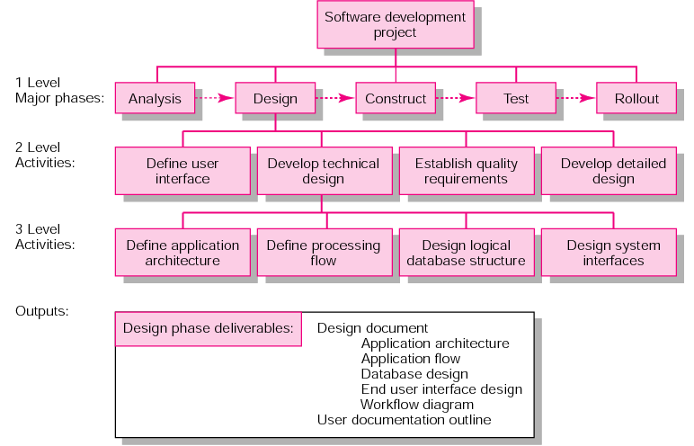
PBS for Software Project Development
FIGURE 4.8

Slide 24
Responsibility Matrices
Responsibility Matrix (RM)
  Also called a linear responsibility chart.
  Summarizes the tasks to be accomplished and who is responsible for what on the project.
    Lists project activities and participants.
    Clarifies critical interfaces between units and individuals that need coordination.
    Provide a means for all participants to view their responsibilities and agree on their assignments.
    Clarifies the extent or type of authority that can be exercised by each participant.

Slide 25
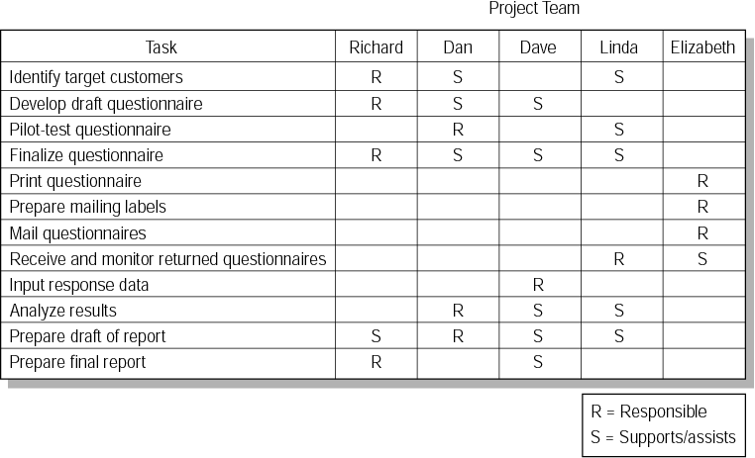
Responsibility Matrix for a Market Research Project
FIGURE 4.9

Slide 26
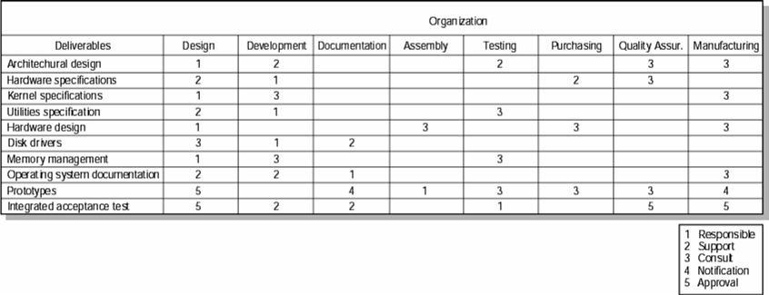
Responsibility Matrix for the Conveyor Belt Project
FIGURE 4.10

Slide 27
Project Communication Plan
What information needs to be collected
and when?
Who will receive the information?
What methods will be used to gather
and store information?
What are the limits, if any, on who has access to certain kinds of information?
When will the information be communicated?
How will it be communicated?
4–<number>

Slide 28
Key Terms
Cost account
Milestone
Organization breakdown structure (OBS)
Scope creep
Priority matrix
Responsibility matrix
Scope statement
Process breakdown structure (PBS)
Work breakdown structure (WBS)
Work package
4–<number>

